Slide 1
Database Project Report Course No:CSE 3104 Course Name:Database Lab
Prepared for:
Mr. Mir Tafseer Nayeem
Mr. Nazmus Sakib
Prepared by:
Syed Sanzam
16.01.04.042
&
Nusrat Hossain Anika
16.01.04.045

Slide 2

Gamers’ Logbook

Slide 3
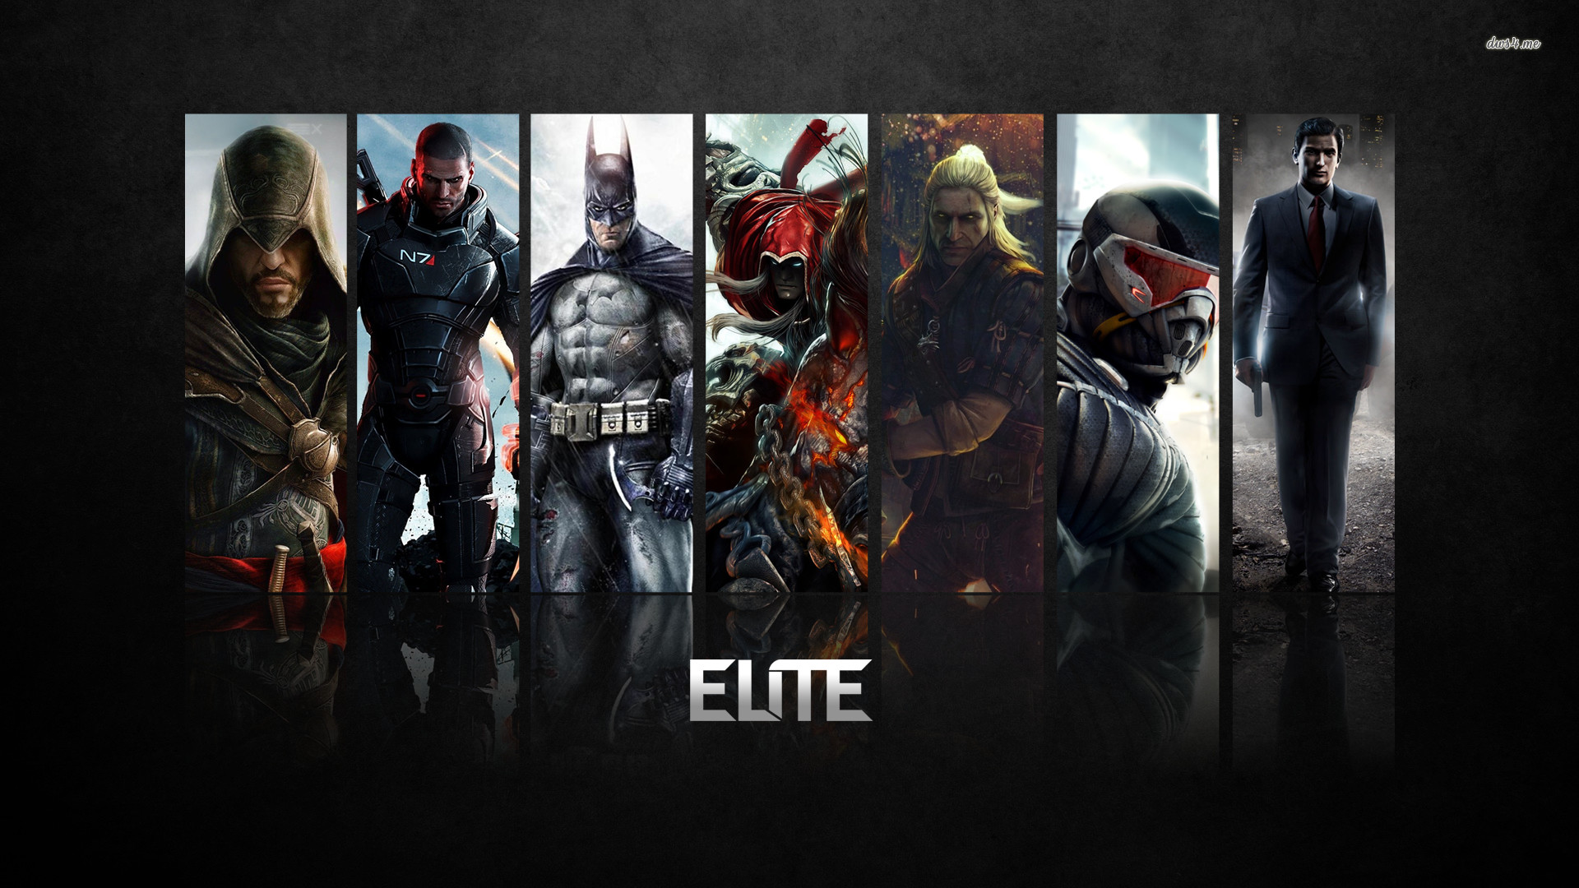
Objective
This is an environment that enables the users to arrange data in an orderly fashion so that data can be retireved in no time when required.
This management system is designed specifically for people who are enthusiastic about Video Games and indulge in gaming on daily basis.

Slide 4

Features
Easiness in data management
Normalized entity set
Multi-user access
Vast range of queries
Future modification opportunity

Slide 5
User Classification
General User
Admin
General User Queries
Admin Queries
Store and Retrieve Data
Queries (1-30)
Change/ModifyData
Queries (31-45) .

Slide 6
User Vs Admin Queries
User Queries
These queries are performed for general purposes. These do not change the structure of database.
Example: select * from Games where Descriptions like 'Sh%';
Admin Queries
These queries are performed for extensive tasks such as changing or modifying data. Admin queries often result in a changed database structure.
Example: update Gamewise_Teams set TeamID = 04 where TeamID = 02 and GameCode = 'A002';

Slide 7
Entities and Primary Keys
1.Games(­GameCode)
2.Players(PlayerID)
3.Teams(TeamID)
4.Team_Players(TeamID,PlayerID)
5.Matches(MatchID)
6.Player_Ranking(PlayerID,GameCode)
7.Gamewise_Teams(GameCode,TeamID)

Slide 8
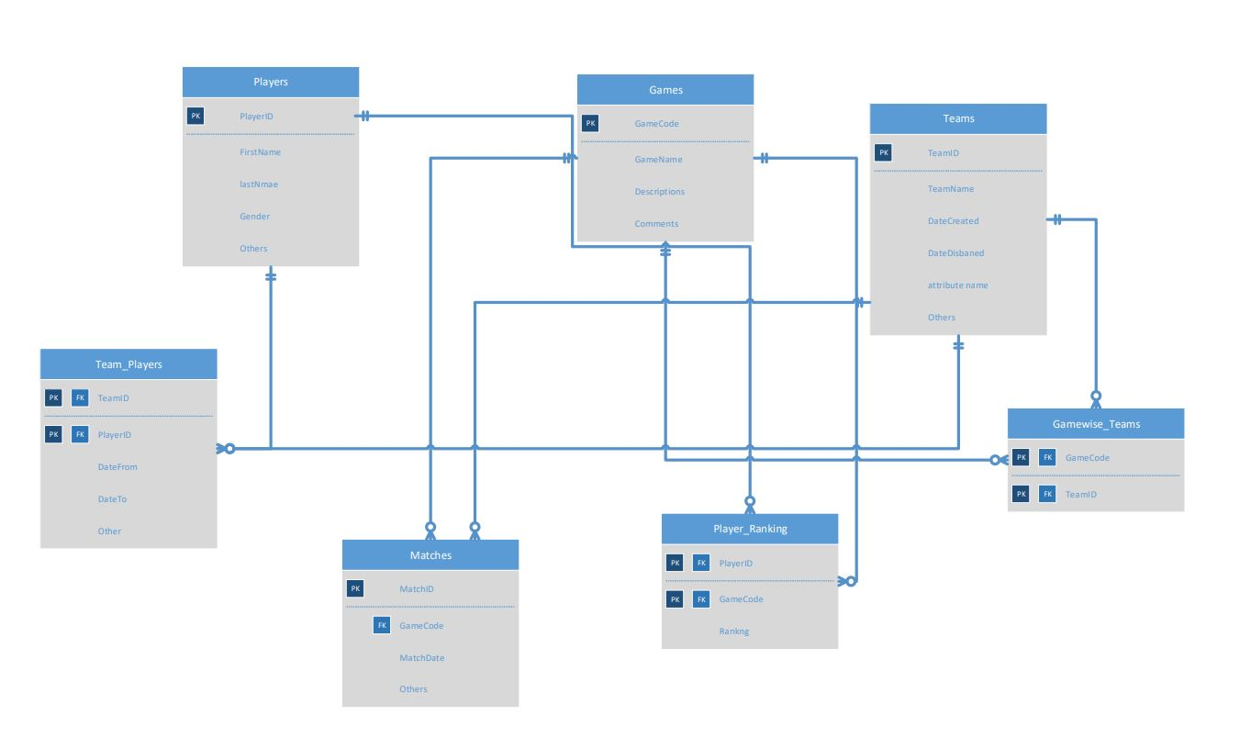
Entity-Relationship Diagram

Slide 9

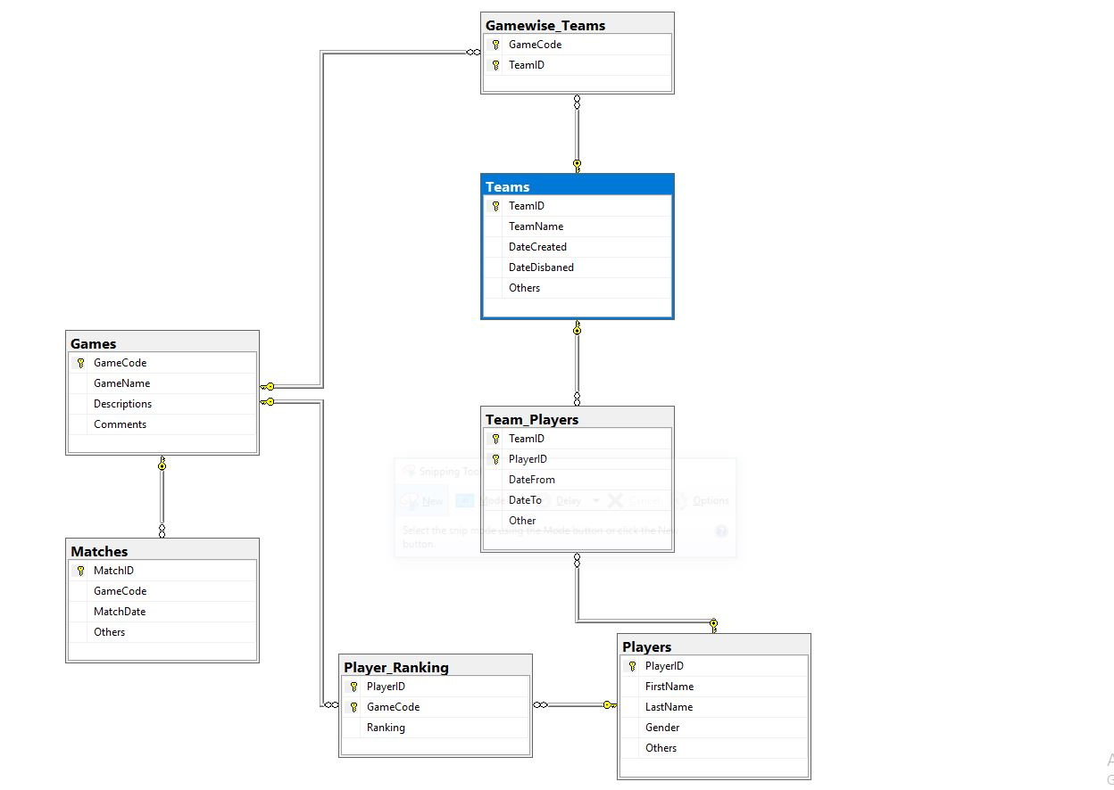
Database Diagram

Slide 10
Limitations
This system is not for everyone to use. It is designed specifically for those who are enthusiastic about Video Games and indulge in gaming on a daily basis and want to keep track of all their records.

Slide 11
Future Work
Gaming is and always has been a great source of entertainment for everyone. Nowadays some people are even considering it as a career option. E-Sports has become a phenomenon among many young adults. A system like this can be introduced to many websites or even tournaments. Some slight modifications such as storing more information and building even stronger relations can make this project shine the brightest.

Slide 12
Thanks!
We would love to answer anything related to our beloved work
We are always available @
sanzamsyed71@gmail.com
nusratanika04@gmail.com

